Slide 1
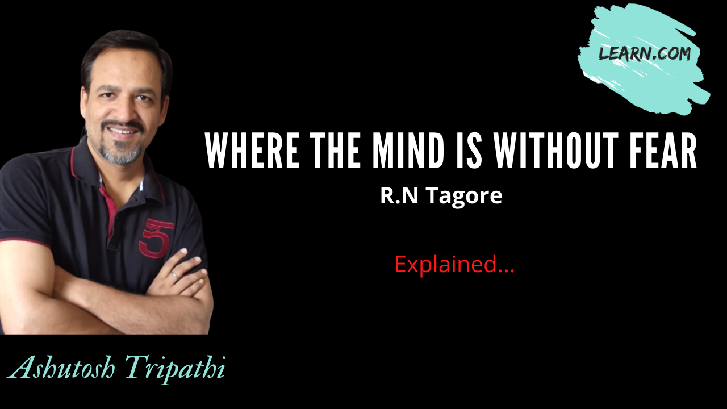

Slide 2


Where the mind is without fear
Where the mind is without fear and the head is held high Where knowledge is free Where the world has not been broken up into fragments By narrow domestic walls Where words come out from the depth of truth Where tireless striving stretches its arms towards perfection Where the clear stream of reason has not lost its way Into the dreary desert sand of dead habit Where the mind is led forward by thee Into ever-widening thought and action Into that heaven of freedom, my Father, let my country awake.

Slide 3
Where the mind is without fear and the head is held high Where knowledge is free Where the world has not been broken up into fragments By narrow domestic walls
Meanings :
fragments : a piece broken of
narrow domestic walls : division on the basis of caste,
colour, gender etc.

Slide 4
Where words come out from the depth of truth Where tireless striving stretches its arms towards perfection Where the clear stream of reason has not lost its way Into the dreary desert sand of dead habit
Meanings :
tireless striving : continuous effort and struggle
stretches its arms : aims at achieving a goal
dead habit : old customs or tradition

Slide 5
Where the mind is led forward by thee Into ever-widening thought and action Into that heaven of freedom, my Father, let my country awake.
Meanings :
ever-widening : forever broadening one’s outlook
heaven of freedom: condition of total freedom of thought
action, expression etc.

